Slide 1
Convolution superposition in the time domain

Slide 2
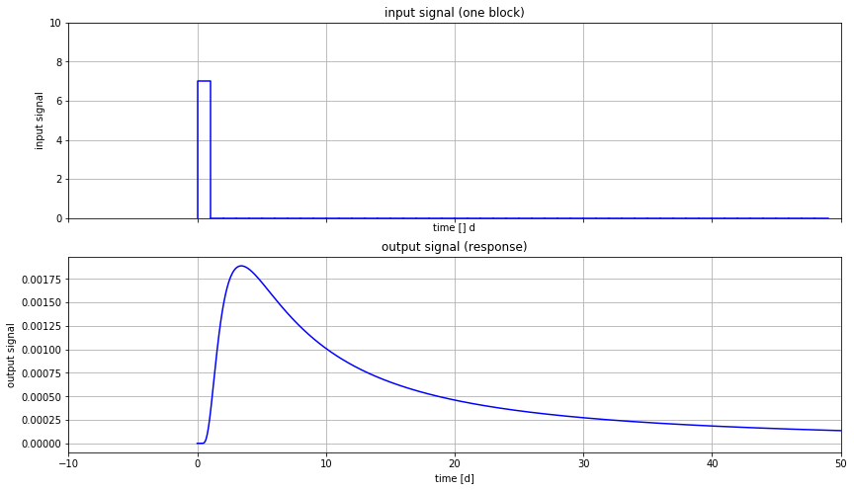

Slide 3
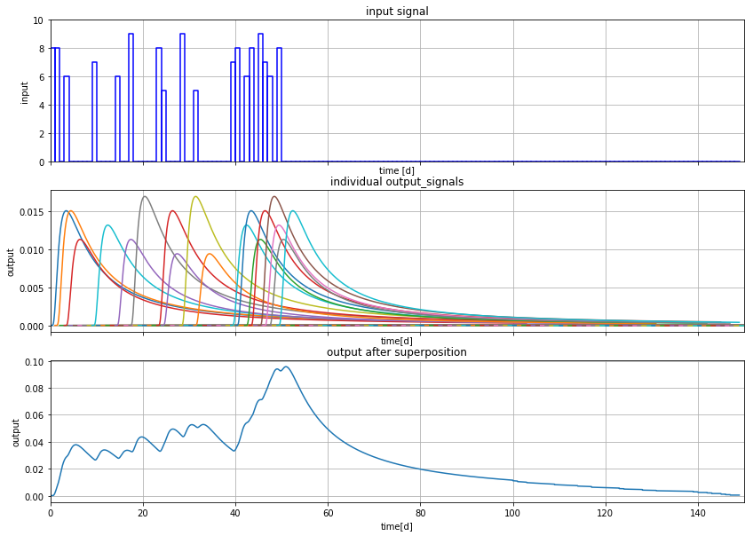

Slide 4
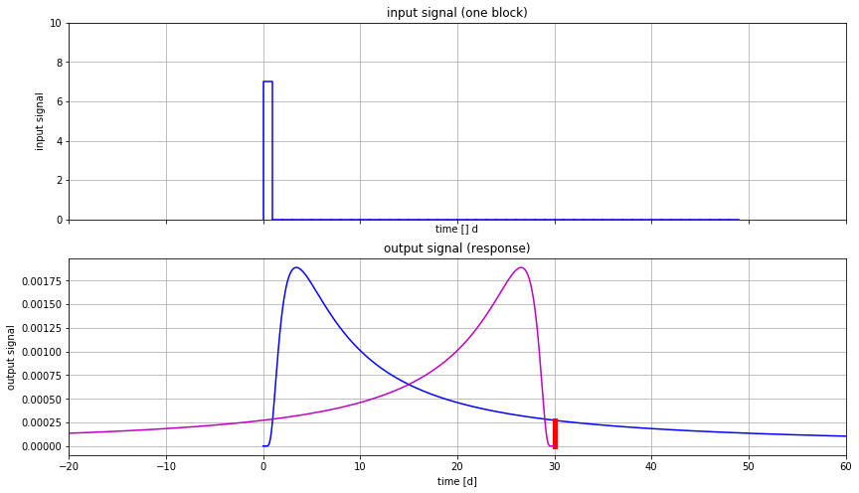

Slide 5
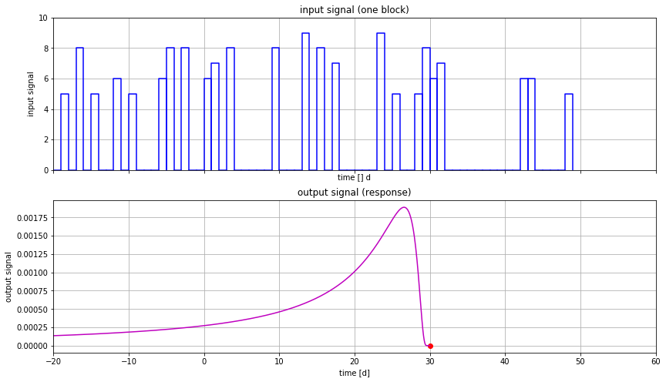

Slide 6
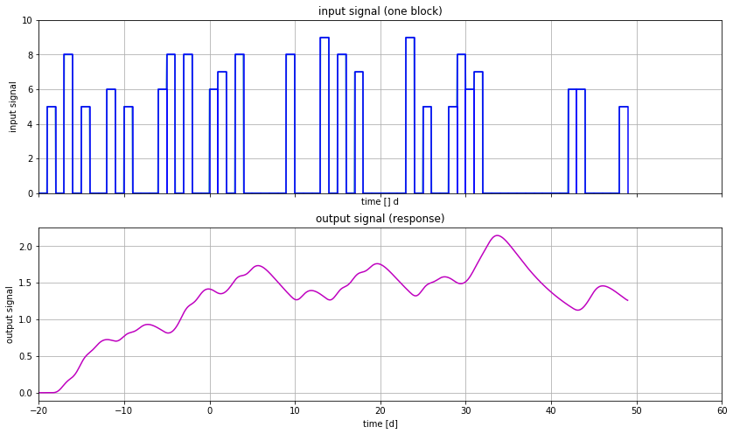

Slide 7
Examples
Groundwater next to a natural river with fluctuation water level
Head due to time-varying Theis well
Head in a groundwater basin driven by varying recharge

Slide 8
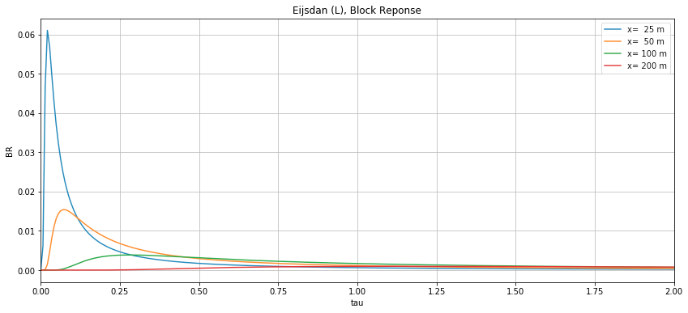
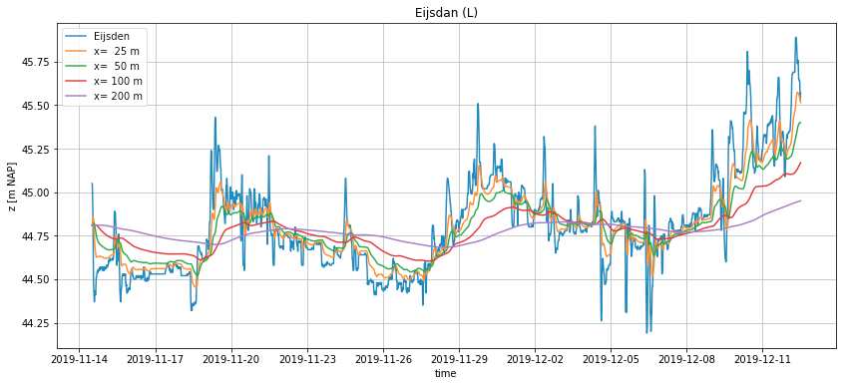
Groundwater next to river
Block responses (d𝜏 = 10 min)
Varying river level with groundwater responses
at different distances from the river

Slide 9
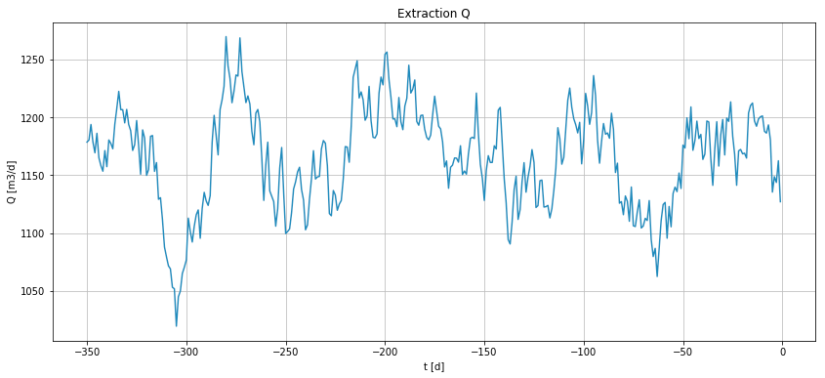
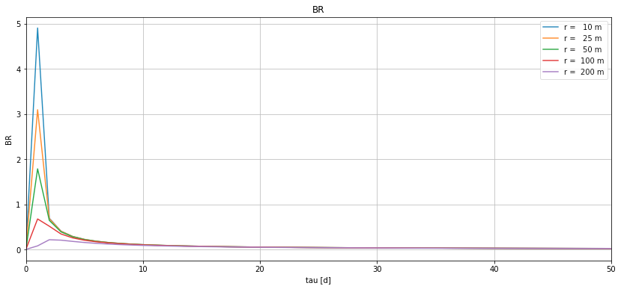
Theis well with varying Q
Time-varying well extraction
Block-responses (d𝜏=1 d), at different distances

Slide 10
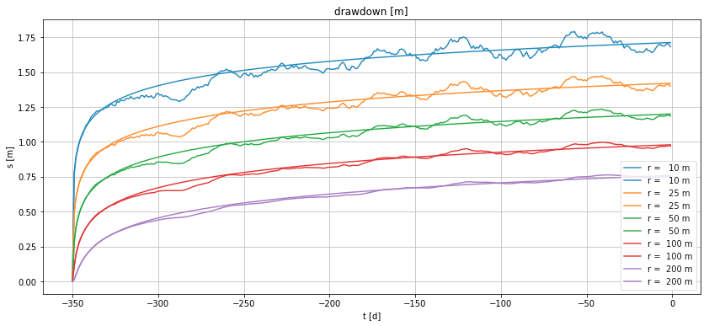
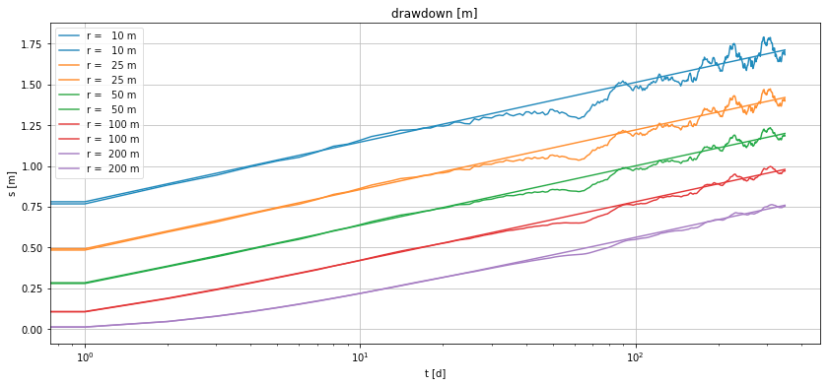
Result of Theis well with varying Q, compare with Theis well with average Q
Drawdown on linear time-axis
Drawdown on logarithmic time-axis

Slide 11
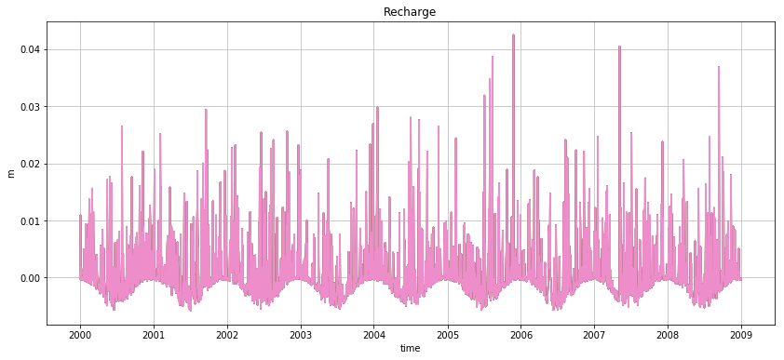
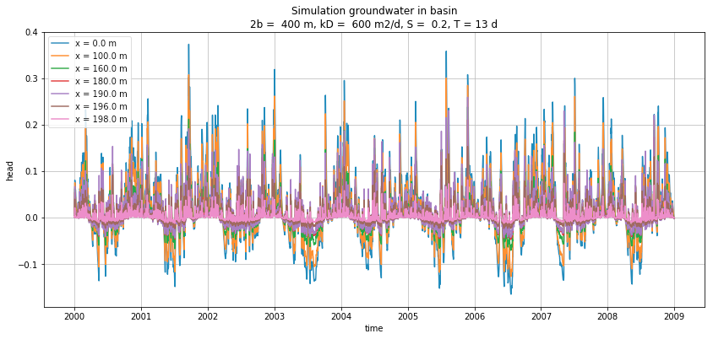
Groundwater head in land between rivers under varying recharge
Daily recharge figures
Response in 400 m wide basin

Slide 12
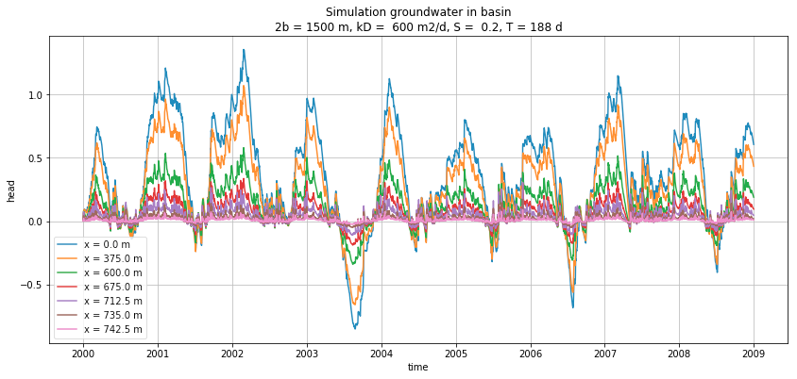
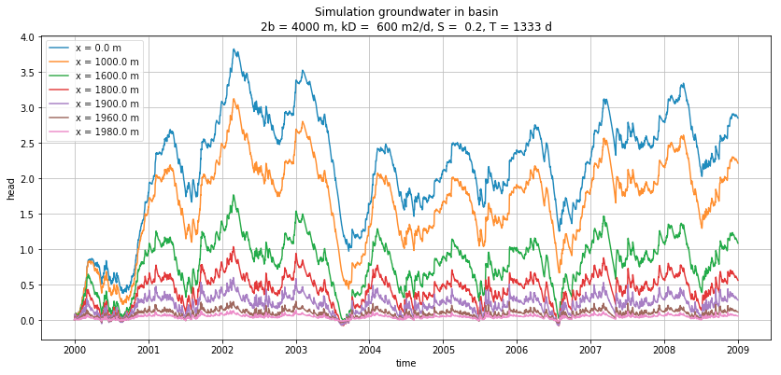
Response in 1500 m wide basin
Response in 4000 m wide basin

Slide 13
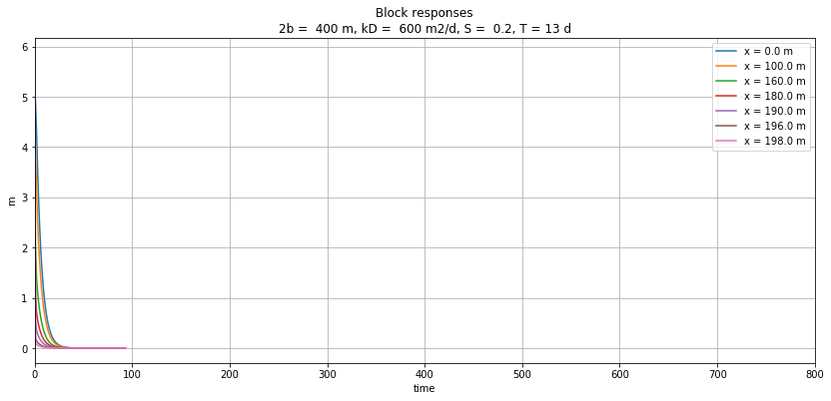
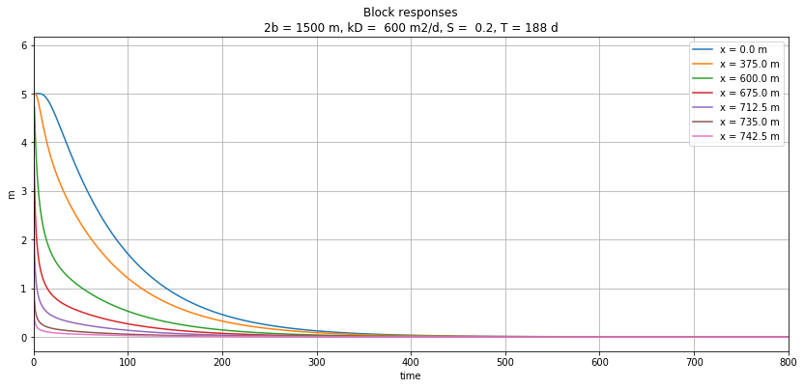
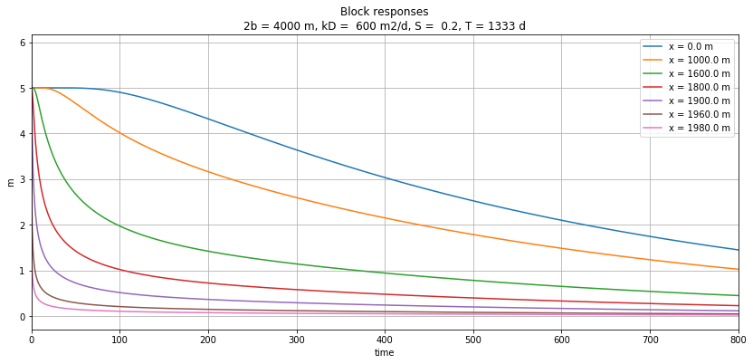
Block responses d𝜏 = 1d
Basin is 400 m wide
Basin is 1500 m wide
Basin is 4000 m wide

Slide 14
Groundwater flow solutions are often step responses
See the two examples we had before:
Sudden change of river level
Sudden start of pumping a well

Slide 15
Step response
Head,
Concentration,
Temperature
or whatever
t

Slide 16
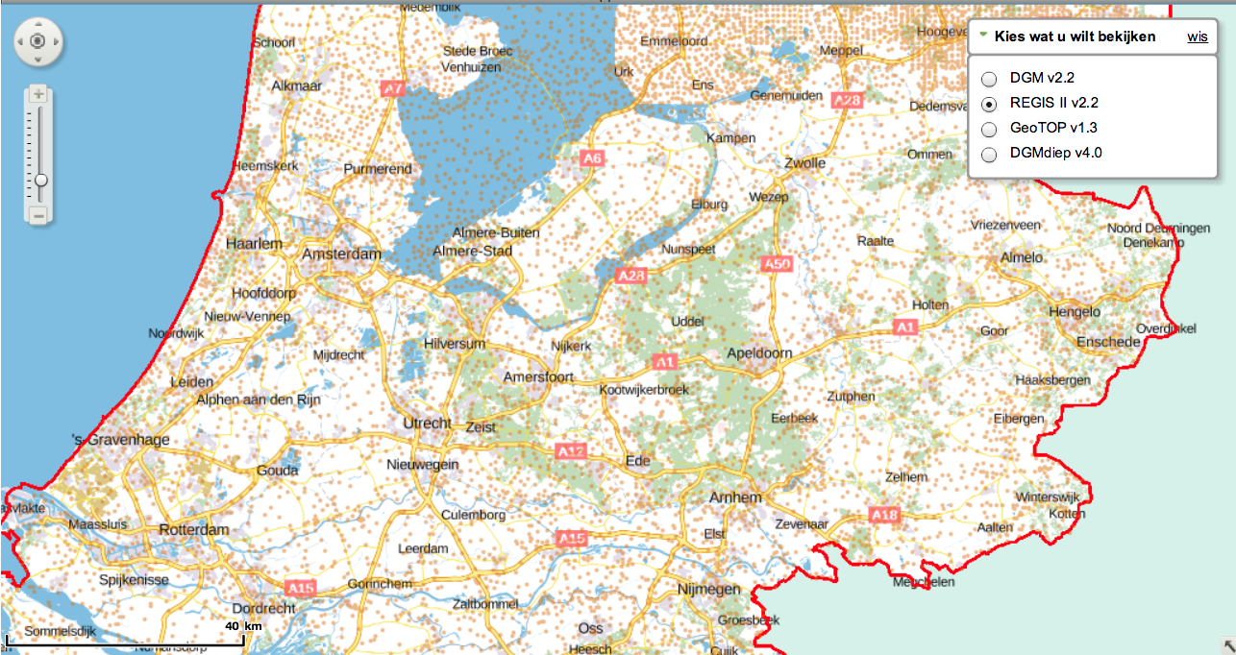
Example groundwater fluctuation depending on distance to boundary

Slide 17
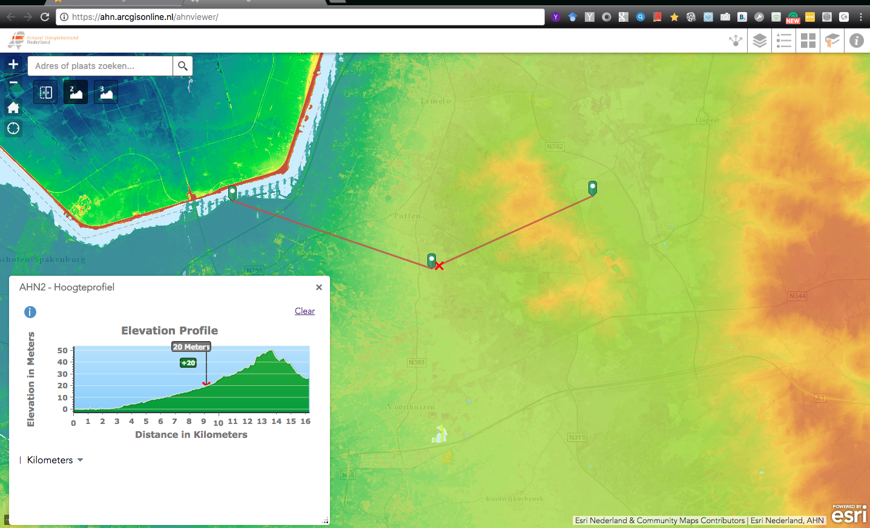

Slide 18
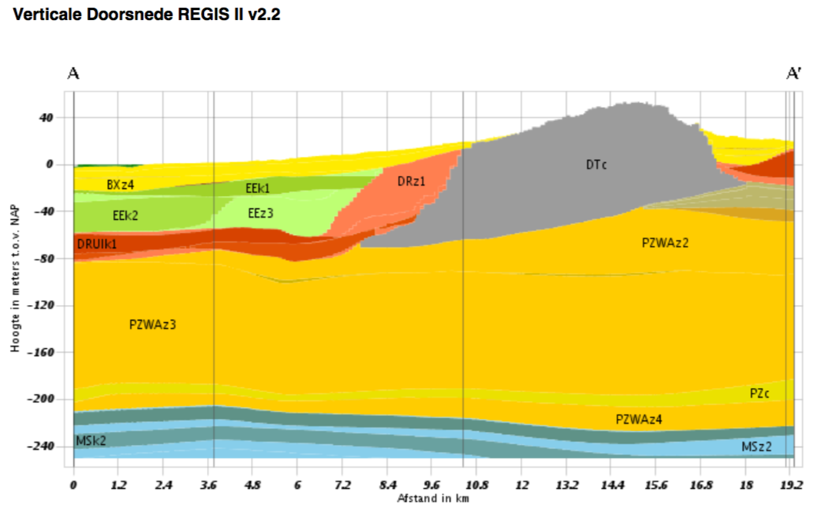
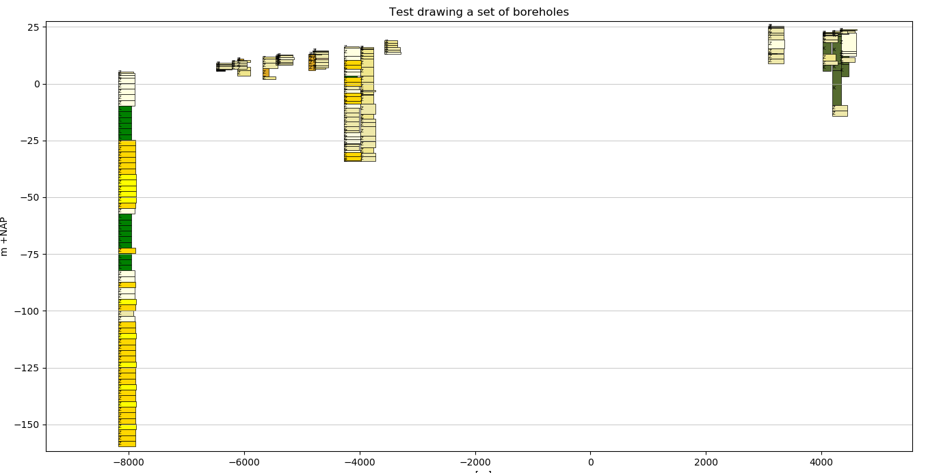

Slide 19
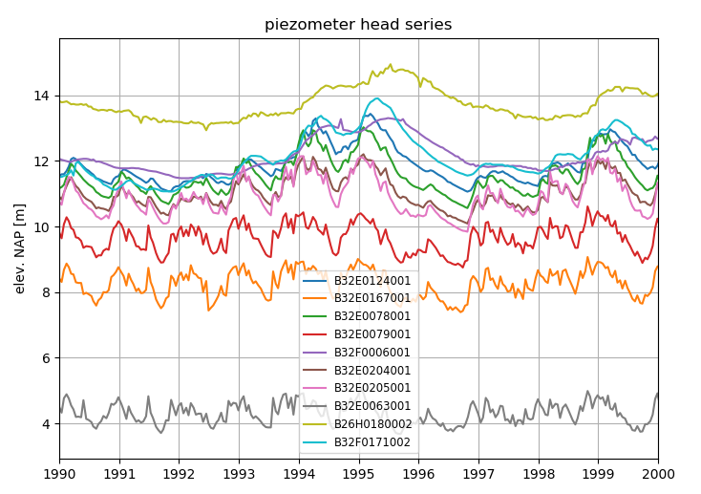

Slide 20
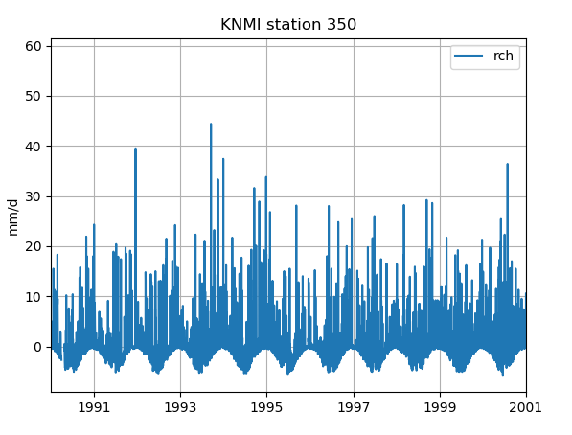
Precipitation – evapotranspiration (daily figures)

